Slide 1
Relationship between volatility of pain and emotions
2022/6/28
Toru Maekawa

Slide 2
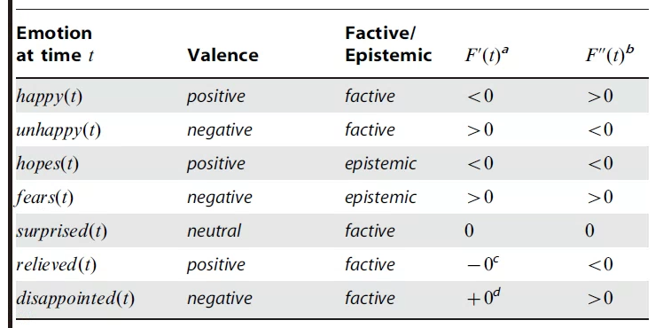
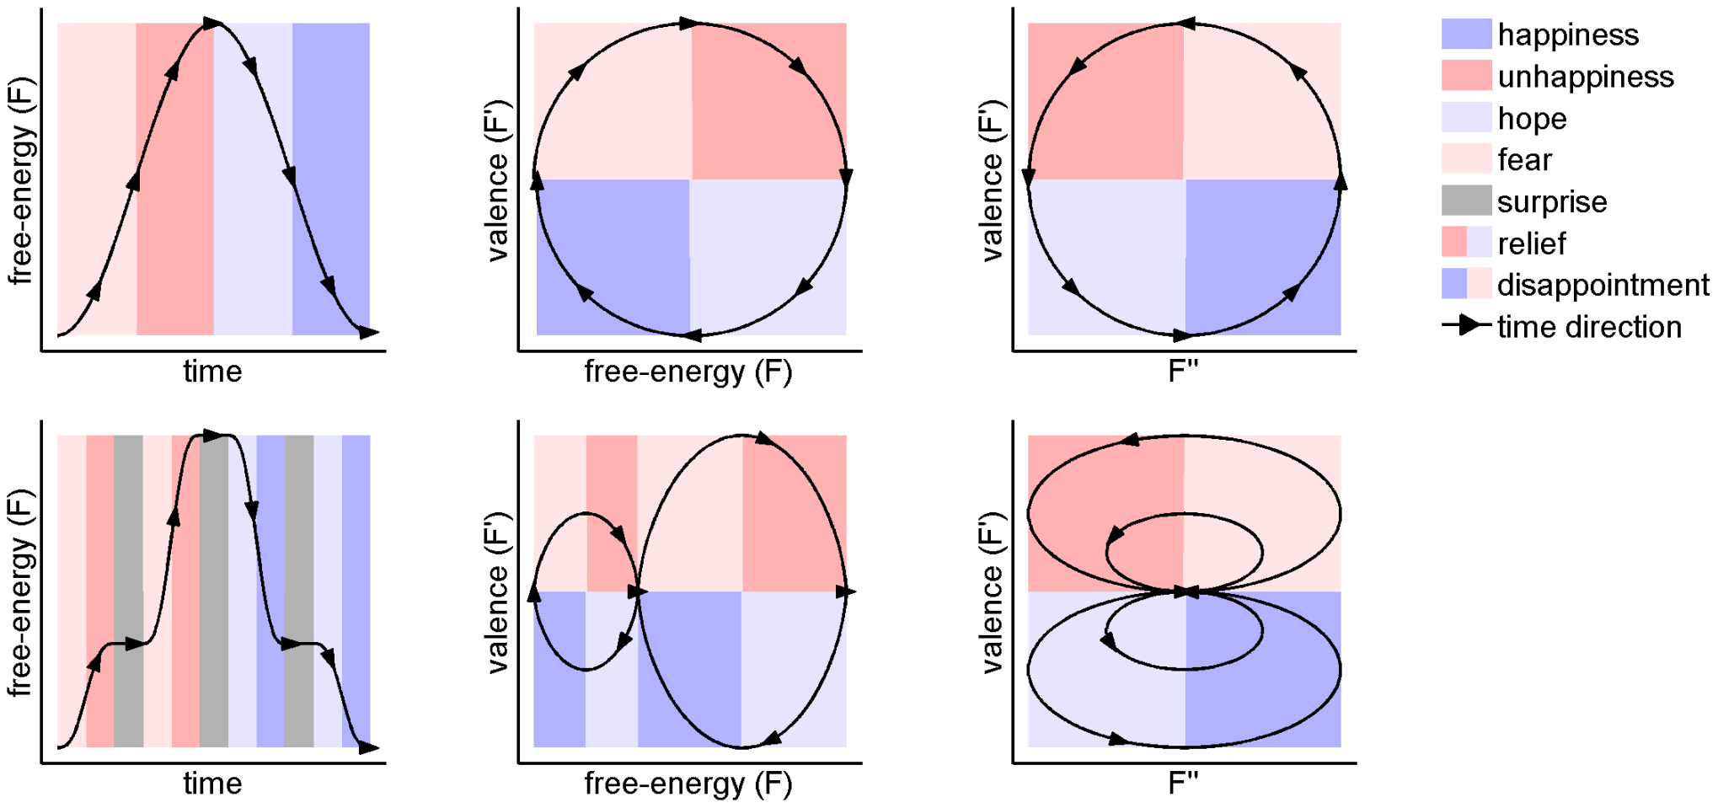
Emotion and free-energy
Joffily, M., & Coricelli, G. (2013). Emotional valence and the free-energy principle. PLoS Computational Biology, 9(6), e1003094.
Emotion is the rate of change of free-energy.
Emotion play a role in biological agents' adaptation to unexpected changes in their world.
Notes:
Previously, Sasaoka-sensei talked about this research.
This study is an opinion paper.
The authors suggested that changes in free energy are associated with emotional valence.
This table shows the changes in free energy and the emotions that result from it.
This figure illustrates it.
For example, the top column suggests that reduced free energy leads to happiness.
In other words, you will feel happy if your input is more stable and more predictable.
The summary is as follows.
Emotion is the rate of change of free-energy.
Emotion play a role in biological agents' adaptation to unexpected changes in their world.

Slide 3
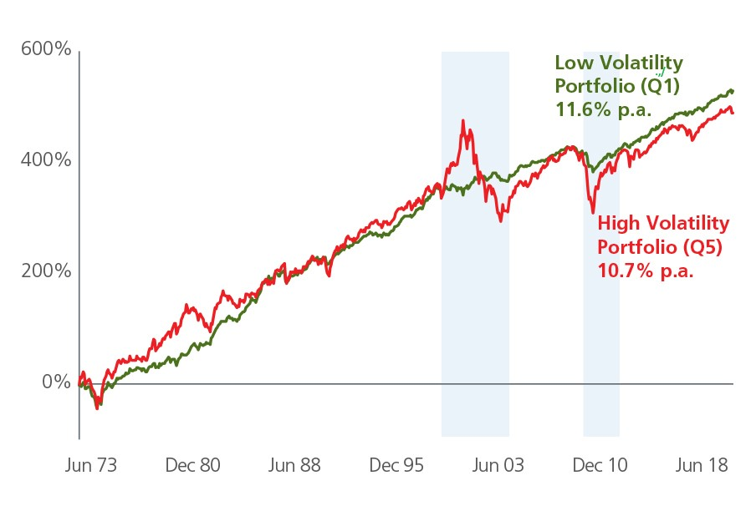
Unexpected changes in their world ⇒ volatility
Volatility is a measure of stability of statistical parameters (e.g., mean or variance) in a stochastic system.
Emotions
Red: nervous, tense, sad
Green: relax, happy
Notes:
So let me explain in a little more detail about the unexpected changes in the world.
In this paper, the magnitude of the unexpected change in the world is called volatility.
Volatility is a term originally from the field of finance.
This figure shows stock price changes.
There are red and green lines, both of which have similar changes.
However, the red line changes significantly up and down compared to the green line.
This red-like change is called high volatility.
This greenish change is called low volatility.
Now consider the feelings of a stock trader.
When volatility is high, they are presumed to be nervous and tense because of the great risk.
On the other hand, when volatility is low, they are considered relaxed because of the low risk.
This is the relationship between unexpected changes in the world and emotions.

Slide 4
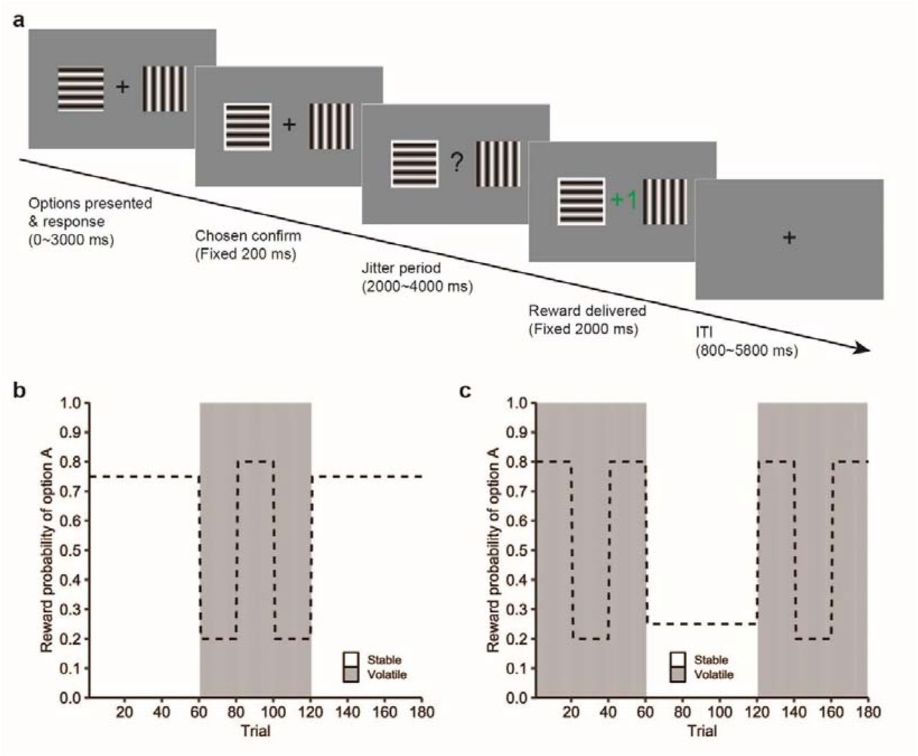
Volatility
In reward paradigms, volatility refers to the stability of the probability with which rewards are associated with cues (environmental states or actions).
Under stable condition
Participants should adapt slowly to reduce the effects of noise and to behave in a stable manner.
Under volatile condition
Participants should adapt quickly to respond to successive changes in the environment
Stable -> low learning rate
Volatile -> high learning rate
Xu et al., 2021
Notes:
In reward paradigms, volatility refers to the stability of the probability with which rewards are associated with cues.
This is an example of a simple experiment.
Participants choose between vertical and horizontal stripes to get rewards.
The figure below shows the probability of getting a reward when participants select vertical stripes.
At first, they can get a reward by choosing vertical stripes.
However, the probability changes on the way, and they will be able to get rewards by choosing horizontal stripes.
The relationship between cue and reward changes frequently in the volatile condition, and not so much in the stable condition.
In order for participants to maximize their rewards, stable conditions require constant choices.
On the other hand, volatile conditions require quick switching of selections.
In other words, participants should have a low learning rate in stable conditions and a high learning rate in volatile conditions.

Slide 5
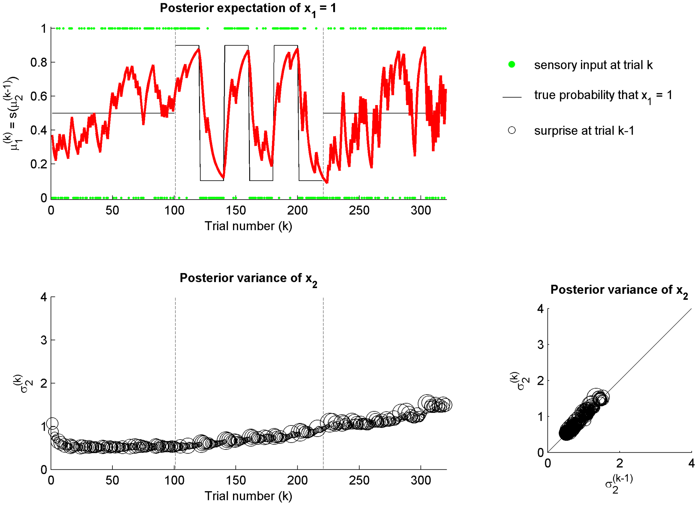
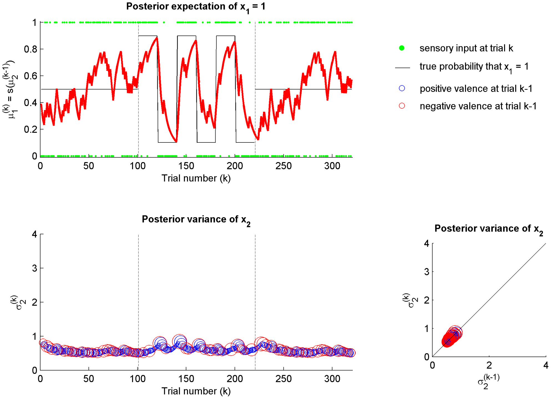
Relationship between emotions and volatility
Joffily, M., & Coricelli, G. (2013). Emotional valence and the free-energy principle. PLoS Computational Biology, 9(6), e1003094.
Rate of change in free-energy ⇒ emotions
Left: Model including volatility parameters
Right: Model with emotional parameters
Emotions control learning rates and help adapt to changes in environmental volatility.
Notes:
Return to the first study.
Computer simulations have shown that emotions can help us adapt well to this stable and volatile condition.
The left is the result of a model that incorporates volatility into the parameters.
The solid line in the above figure is the change in reward probability, and the red line is the selection rate of participants.
This participant is well learned the changes in the environment.
On the other hand, the model on the right includes emotional parameters calculated from changes in free energy.
Even with this model, participants are able to respond well to changes in the environment.
Therefore, it is speculated that emotions are useful in coping with changes in the environment.
In this study, we aim to clarify the processing of emotions using experiments in this volatility paradigm.

Slide 6
Pain stimulus
Pain is related to emotion.
Emotion and pain are known to be intimately related (Linton, 2013).
Pain is related to interoception.
That is, pain is both an aspect of interoception (the sense of the physiological condition of the body) and a specific behavioral motivation (Craig, 2003).
We can investigate the effects of emotional learning more related to interoception by using pain stimuli.
Notes:
In this study, we used pain stimuli.
Many studies have shown that pain is associated with basic emotions.
On the other hand, some researchers include pain in interoception.
Therefore, I thought that it might be possible to investigate the effect on more basic emotions by using pain stimuli.
In this study, we run the experiment with the volatility paradigm using pain stimuli.

Slide 7
Related studies

Slide 8
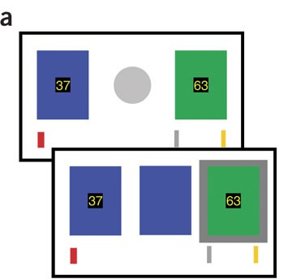
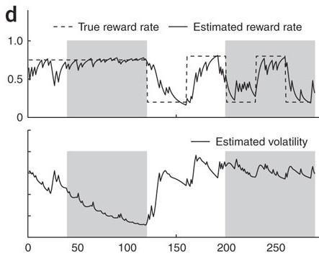
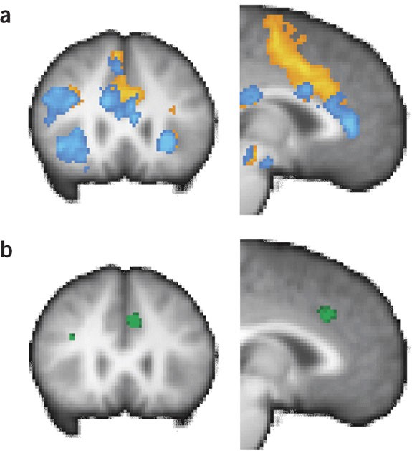
Volatility ⇒ ACC
Behrens, T. E. J., Woolrich, M. W., Walton, M. E., & Rushworth, M. F. S. (2007). Learning the value of information in an uncertain world. Nature Neuroscience, 10(9), 1214-1221.
One-armed bandit task. There is a 75% chance that blue will be the reward (stable condition). 80% chance blue is reward or 80% chance green is reward (volatile condition)
rewards × volatility interaction revealed a circumscribed activation in the ACC (green)
Notes:
Orange is the activity of the decision period, blue is the activity of the reward period.

Slide 9
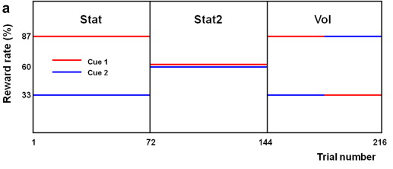
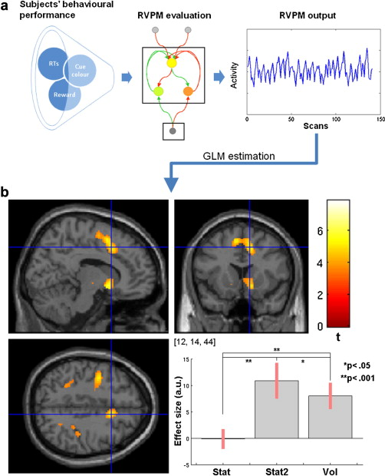
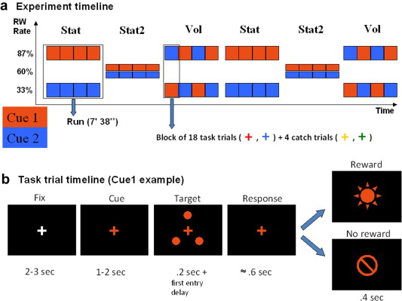
Volatility ⇒ ACC
Silvetti, M., Seurinck, R., & Verguts, T. (2013). Value and prediction error estimation account for volatility effects in ACC: A model-based fMRI study. Cortex, 49(6), 1627-1635.

Slide 10
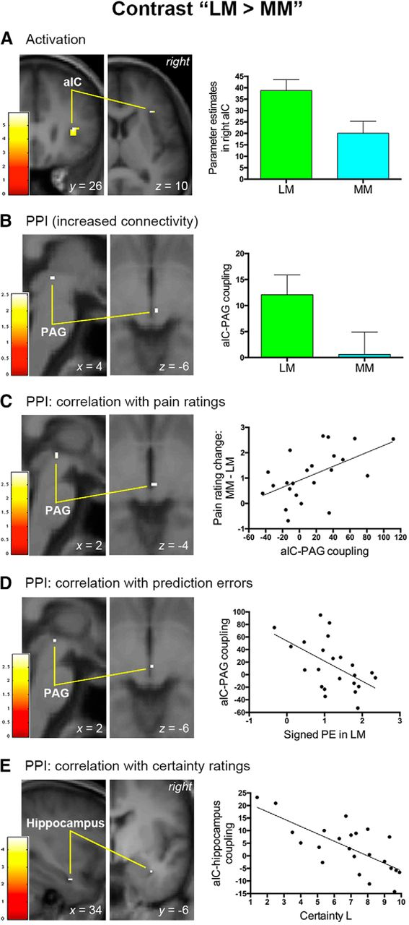
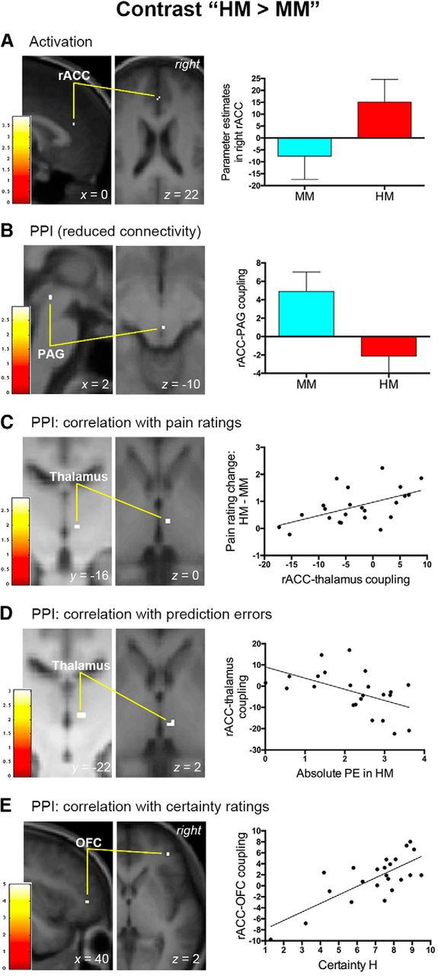
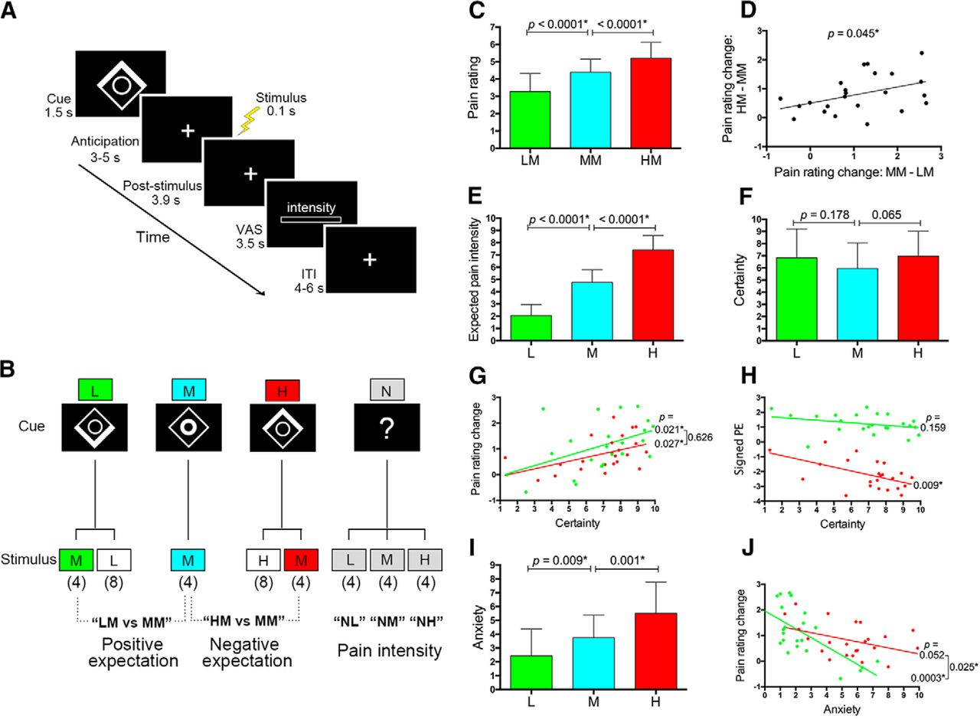
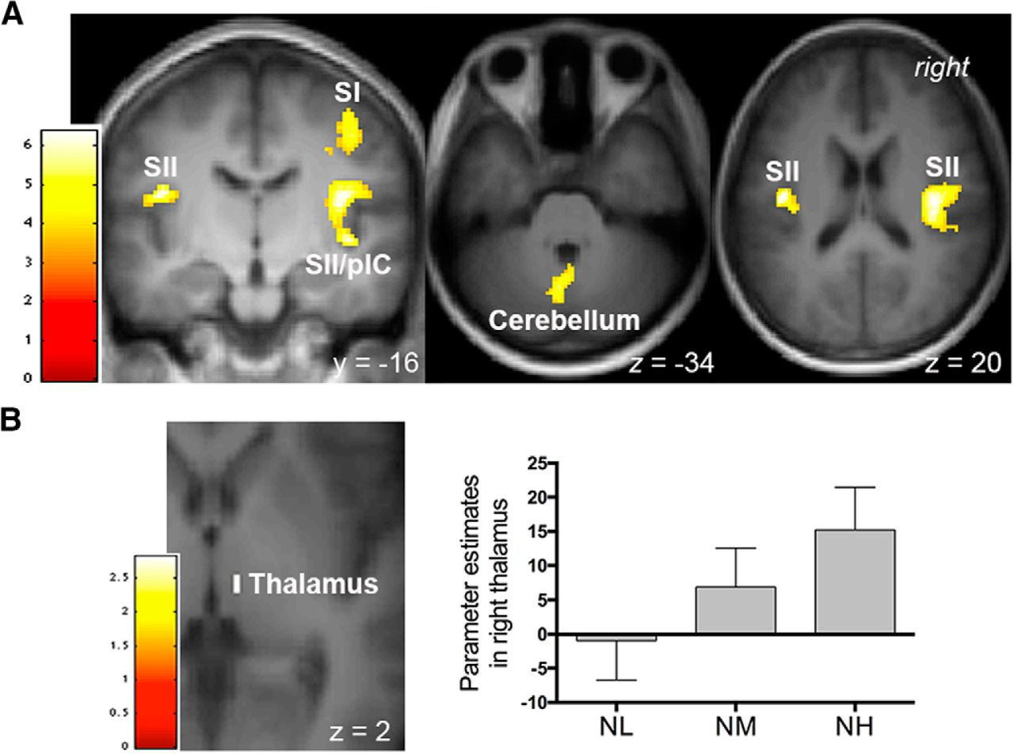
Pain perception ⇒ posterior insula Pain prediction ⇒ anterior insula
Shih, Y.-W., Tsai, H.-Y., Lin, F.-S., Lin, Y.-H., Chiang, C.-Y., Lu, Z.-L., & Tseng, M.-T. (2019). Effects of Positive and Negative Expectations on Human Pain Perception Engage Separate But Interrelated and Dependently Regulated Cerebral Mechanisms. The Journal of Neuroscience, 39(7), 1261-1274.
L：positive prediction
（weak stimulus）
R：negative prediction
（strong stimulus）
Pain perception

Slide 11
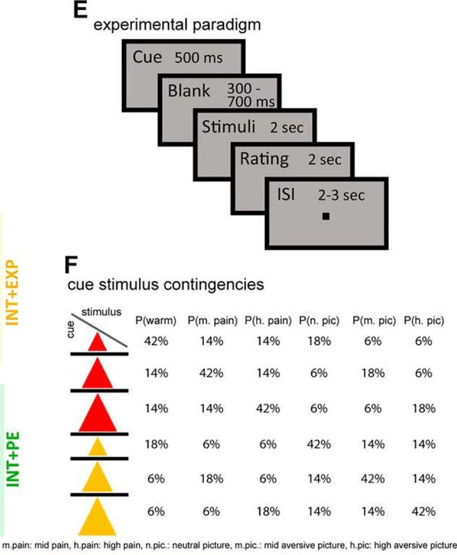
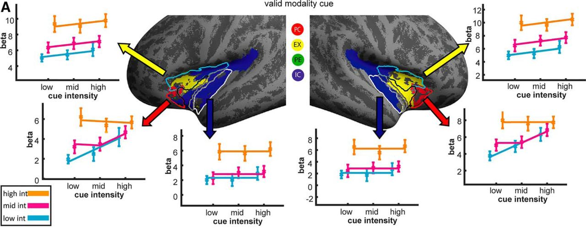
Pain perception ⇒ posterior insula Pain prediction ⇒ anterior insula
Fazeli, S., & Büchel, C. (2018).Pain-Related Expectation and Prediction Error Signals in the Anterior Insula Are Not Related to Aversiveness. The Journal of Neuroscience, 38(29), 6461-6474.
Red： Pain＋Expectation＋Prediction error
Yellow： Pain＋Expectation
Green： Pain＋Prediction error
Blue： Pain
Dorsal anterior insula ⇒ pain, expectation
Ventral anterior insula ⇒ pain, expectation prediction error
Posterior insula ⇒ pain

Slide 12
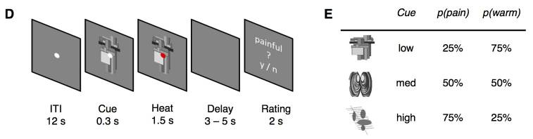
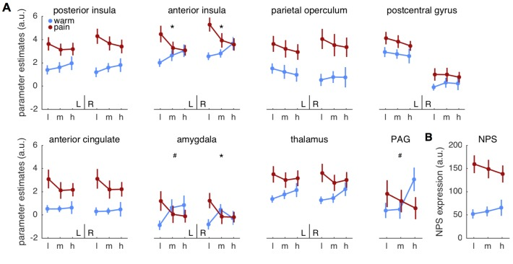
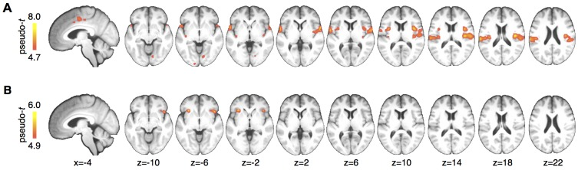
Pain perception ⇒ posterior insula Pain prediction ⇒ anterior insula
Geuter, S., Boll, S., Eippert, F., & Büchel, C. (2017). Functional dissociation of stimulus intensity encoding and predictive coding of pain in the insula. ELife, 6, e24770.
Posterior insula responded to pain and Anterior insula responded to prediction error
(A) strength of pain, (B) Interaction between pain and prediction

Slide 13
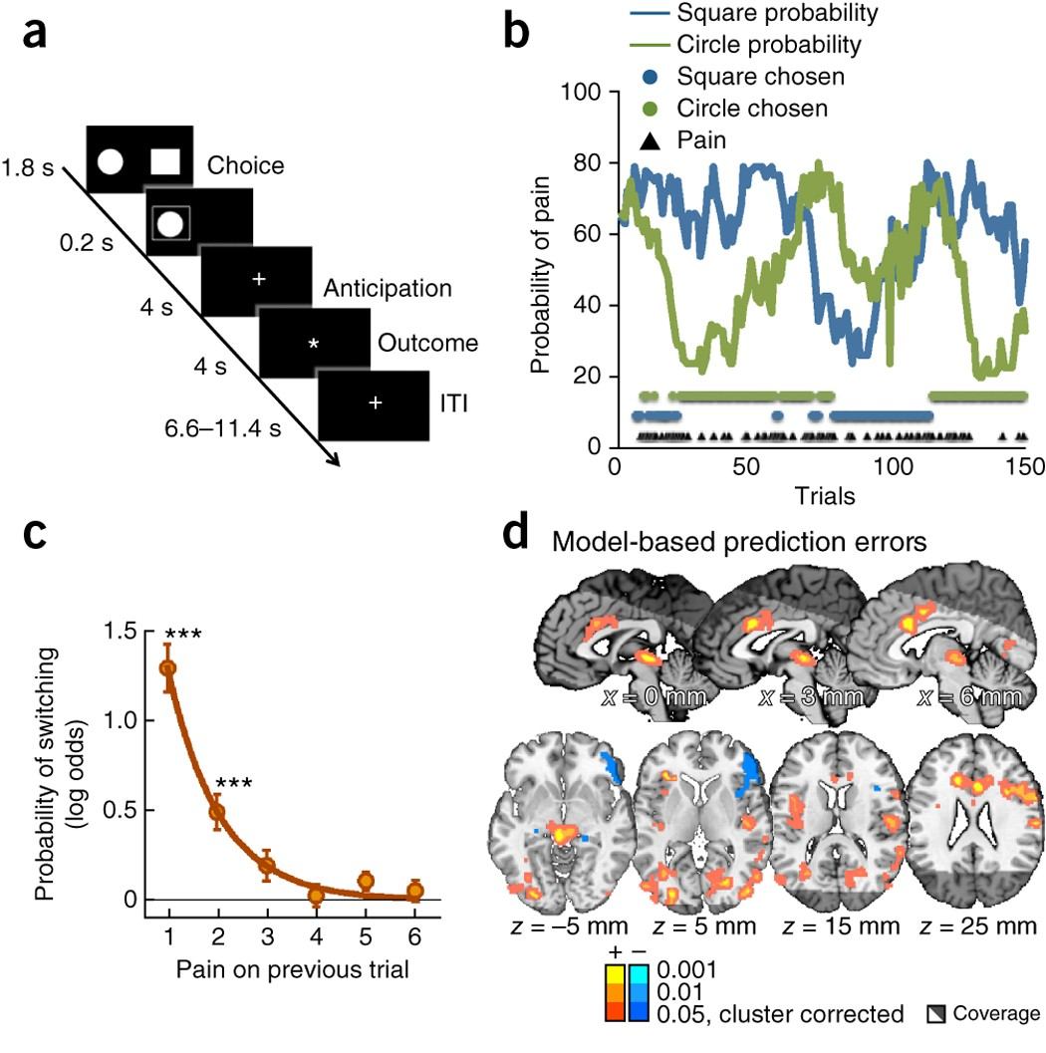
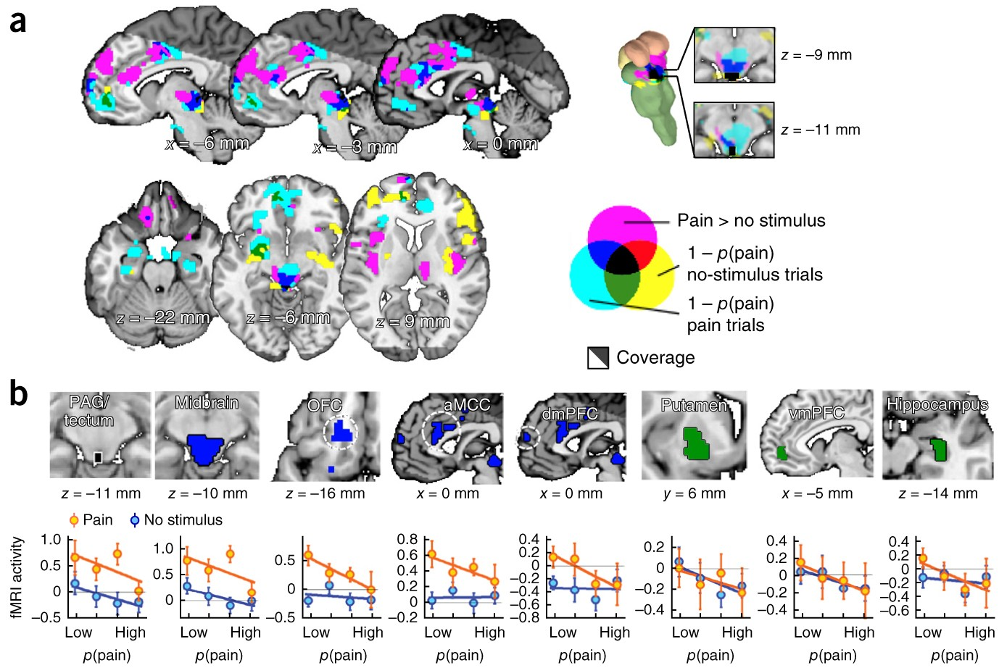
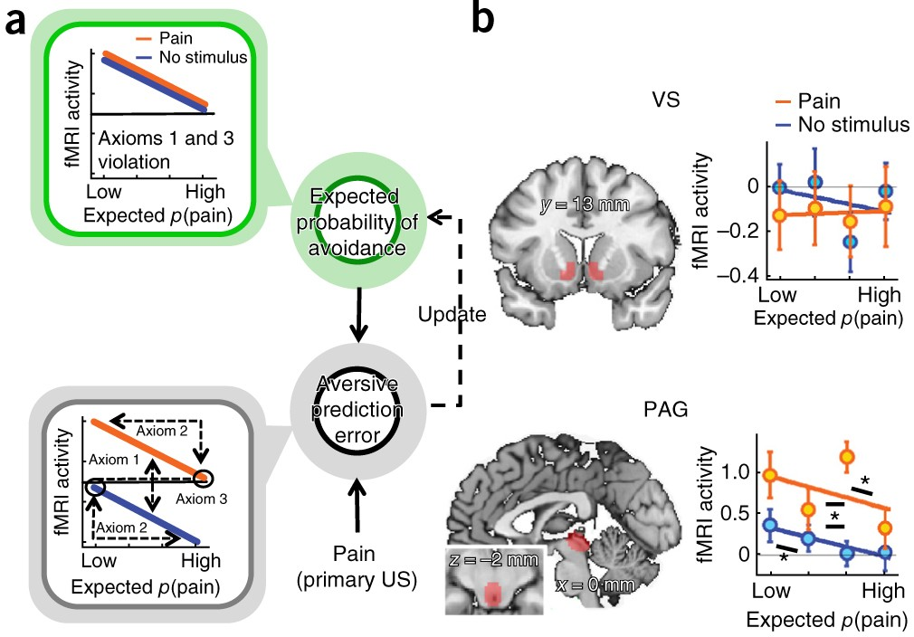
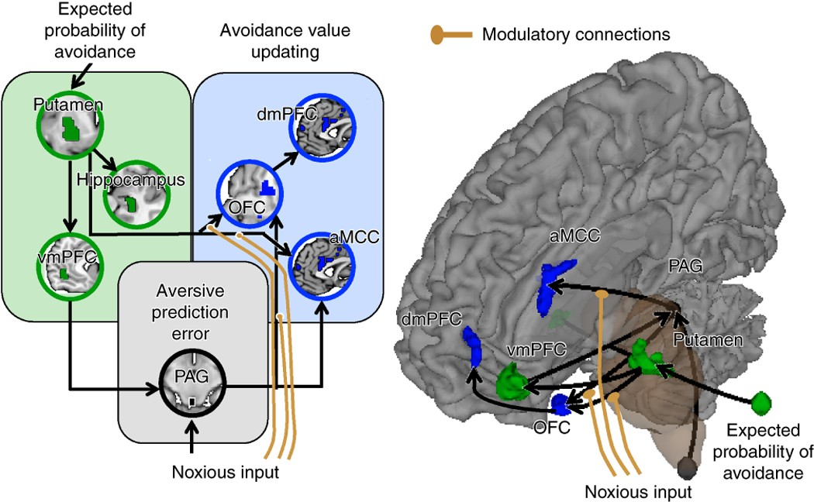
Roy, M., Shohamy, D., Daw, N., Jepma, M., Wimmer, G. E., & Wager, T. D. (2014). Representation of aversive prediction errors in the human periaqueductal gray. Nature Neuroscience, 17(11), 1607-1612.
Left anterior insula, anterior and mid-cingulate cortices (ACC and MCC, respectively), the right pre- and post-central gyri, the right dorsolateral prefrontal cortex and a large cluster in the midbrain encompassing the periaqueductal gray (PAG)

Slide 14
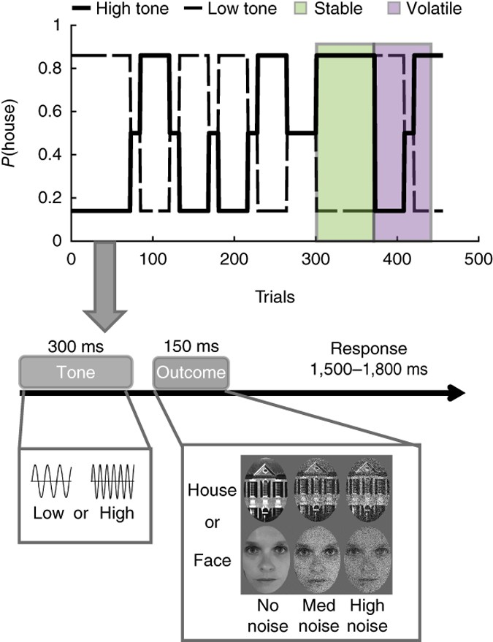
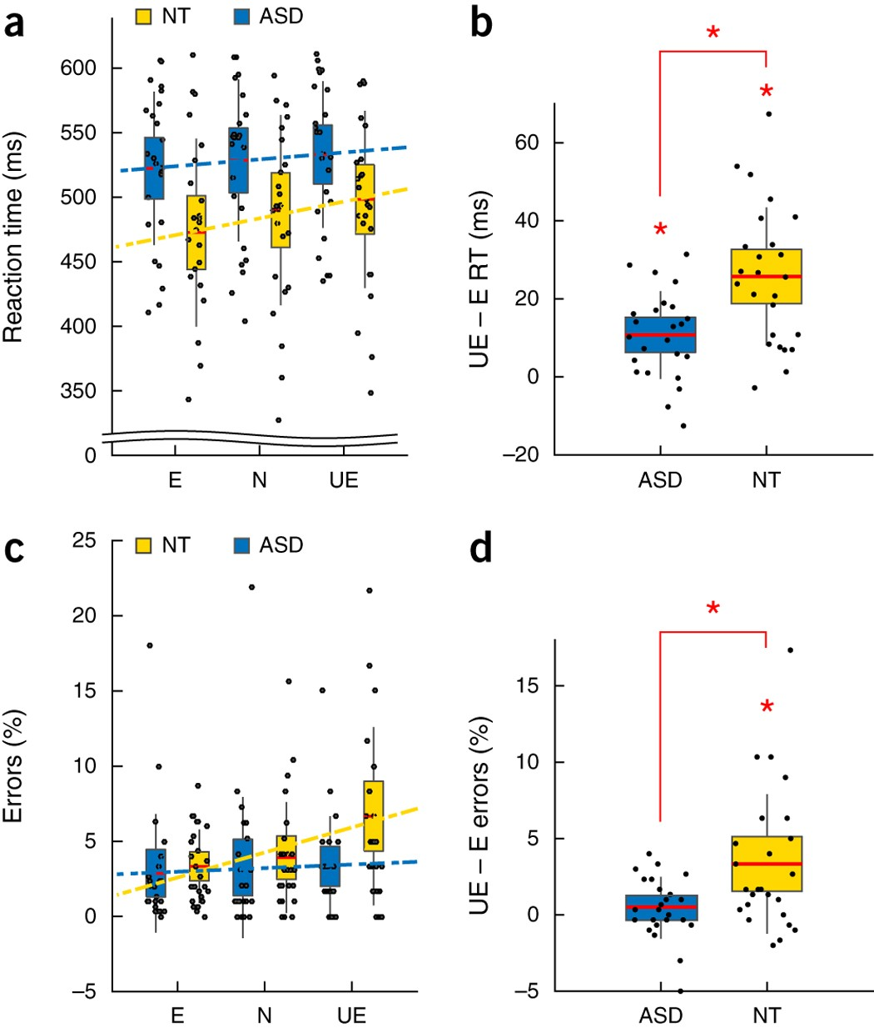
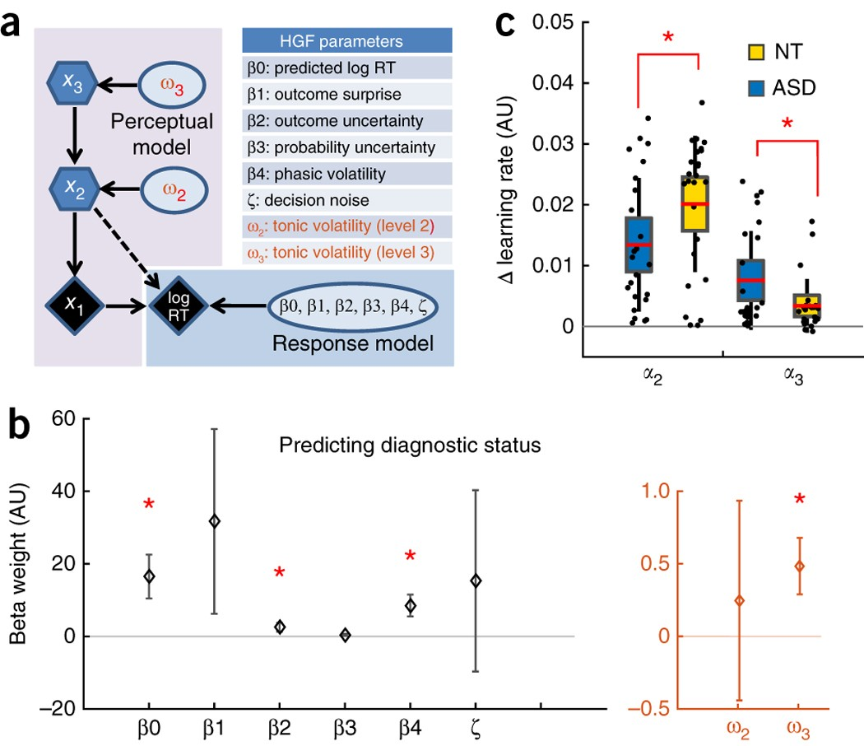
Volatility and autism
Lawson, R. P., Mathys, C., & Rees, G. (2017). Adults with autism overestimate the volatility of the sensory environment. Nature Neuroscience, 20(9), 1293-1299.
ASD tended to have smaller Δα₂ (Fig. 4c), showed reduced behavioral surprise (Fig. 2b) and also larger 'metavolatility' estimates (Fig. 4b).
ASD showed a tendency to overlearn about volatility in the face of environmental change drives a corresponding reduction in learning about probabilistically aberrant events, thus putatively rendering these events less surprising.

Slide 15
Purpose

Slide 16
Expected results
Volatility of monetary reward -> ACC (Behrens et al., 2007; Silvetti et al., 2013)
Volatility of pain -> insula
Volatility relates emotion. (Mathys et al., 2011)
Volatility affects emotion ratings.
Volatility affects BIN measures.
HRV, HEP, EGG
ASD showed unusual behavior to changes in volatility. (Lawson et al., 2017)
Individual differences in personality affect behavior to change in volatility.
BDI, MAIA, BPQ, BRS, RS14, JPSS

Slide 17
Methods

Slide 18
1 trial
Conditions
Cue
A (Gabor 0°)
B (Gabor 90°)
Heat stimuli
Pain（48℃）
Warm（35℃）
Cue-stim probability
A⇒P:80%, W:20% B⇒P:20%, W:80%
A⇒P:20%, W:80% B⇒P:80%, W:20%
Volatility
Volatile: probabilities switched every 10 trials
Stable: same probability lasts for 20 trials
1.0s
0.5s
3.0s
~1.0s
3.0s
4.0s
~2.5s
~3.5s
fixation
Cue
2AFC
Antici-
pation
Stim
Pain
VAS
Affective
grid
1.0
1.5
4.5
5.5
8.5
12.5
15.0
18.5
11.5s + response(~7.0s) × 140 trials = 43’ 10”
Cue-stim conditioning
example）
A⇒P:1 time, W:4 times
B⇒P:4 times, W:1 time
①
②
①
②
①
Volatility
S
V
S

Slide 19

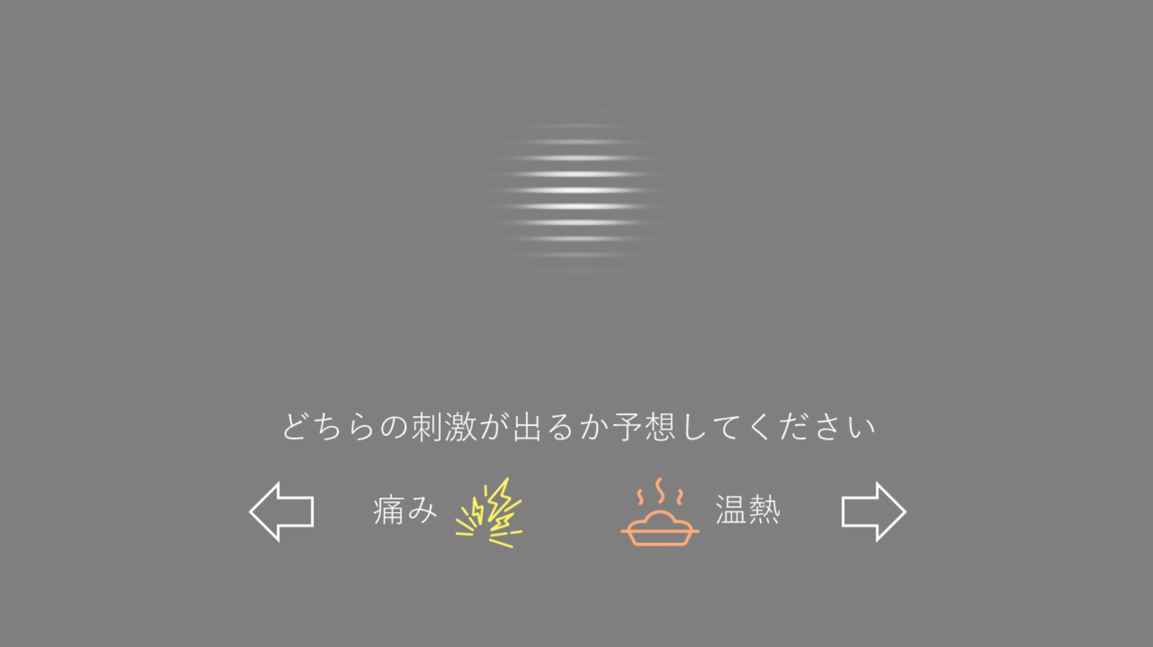

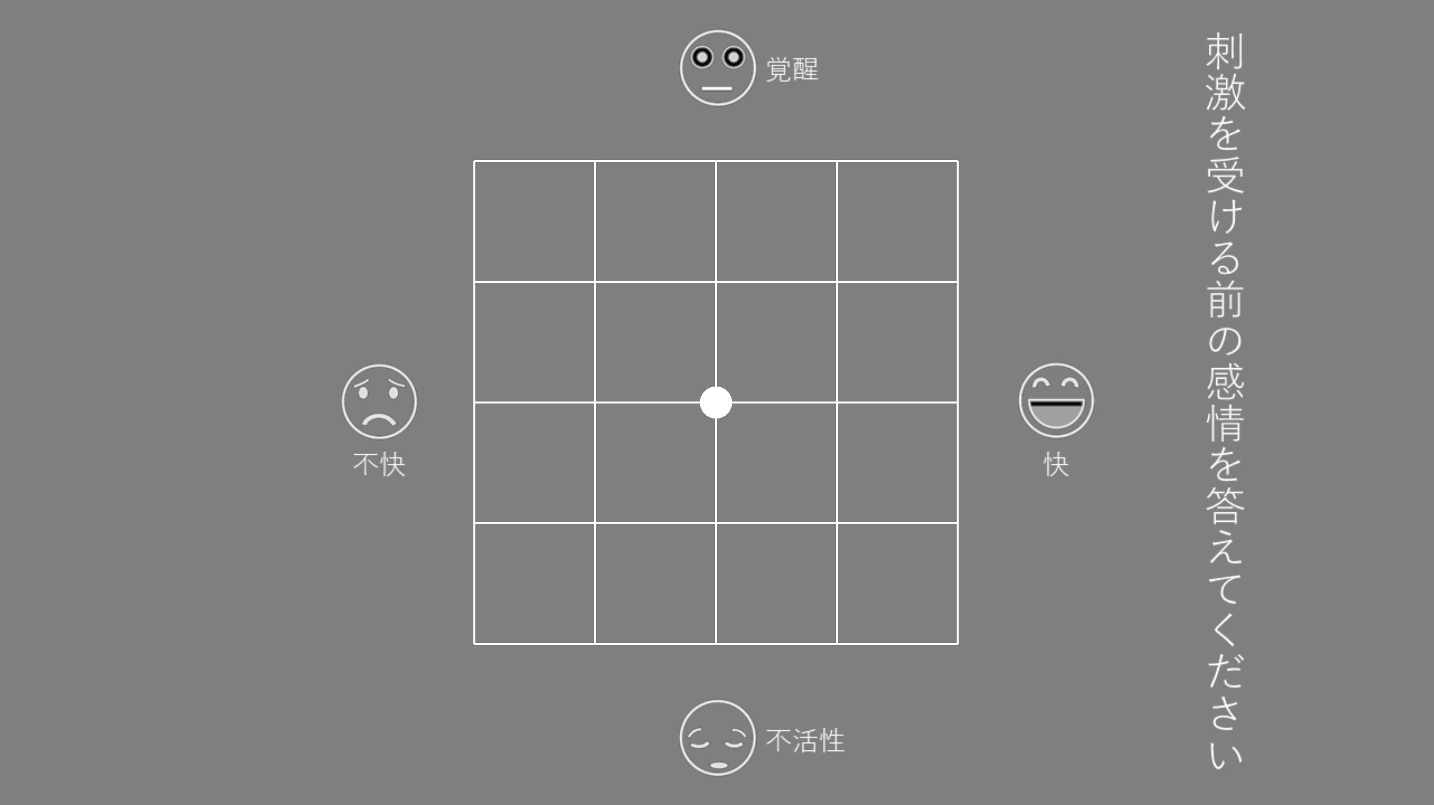
Trial
1.0s
0.5s
3.0s
~1.0s
3.0s
5.0s
~2.5s
~3.5s
Fixation
Cue
2AFC
Anticipation
Stimulus
Pain VAS
Affective grid
1.0
1.5
4.5
5.5
8.5
12.5
15.0
18.5
(11.5 s + 7.0 s（response）) ×140 trials = 43’ 10’’

Slide 20
Measured value
Physiological measures
fMRI
EEG (32ch)
EGG (electrogastrogram, 26ch)
ECG (6ch)
PPG (noisy)
BP (low sampling rate)
Respiration
Skin conductance
Pupil diameter (noisy)
Questionnaires
BDI
MAIA
BRS (Bidimentional Resilience Scale)
RS14
BPQ
JPSS
Task
Pain prediction (2AFC)
Pain VAS
Pain AG

Slide 21
Results

Slide 22
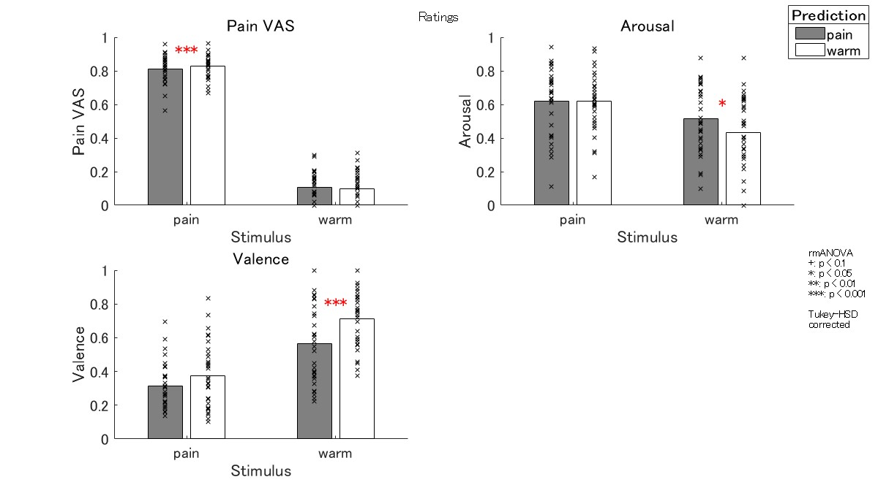
Ratings
Pain VAS: prediction error effect
Arousal: prediction error effect
Valence: free-energy decreasing effect
Notes:
In the VAS, participants felt more pain when they were in pain when they expected the warm. This is thought to be due to the effect of prediction error.
In valence, the response became more positive when participants predicted the warm and received the warm.
This is consistent with the free energy and emotion models introduced at the beginning.
If you have a positive expectation and a positive result that matches it, the free-energy will decrease and you will feel happy.

Slide 23
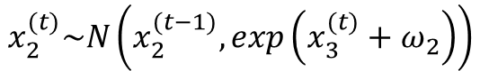
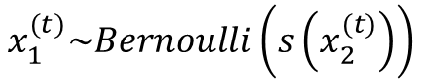
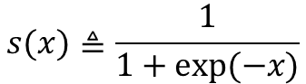
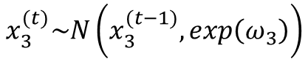
Volatility model
x₃
ω₃
$$x_{3}^{(t)}\sim N\left(x_{3}^{(t−1)},exp\left(ω_{3}\right)\right)$$
Volatility
$$x_{2}^{(t)}\sim N\left(x_{2}^{(t−1)},exp\left(x_{3}^{(t)}+ω_{2}\right)\right)$$
Probability of pain
x₂
ω₂
$$x_{1}^{(t)}\sim Bernoulli\left(s\left(x_{2}^{(t)}\right)\right)$$
Response
x₁
$$s(x)≜\frac{1}{1+exp⁡(−x)}$$
Ref. Lawson et al., 2017

Slide 24
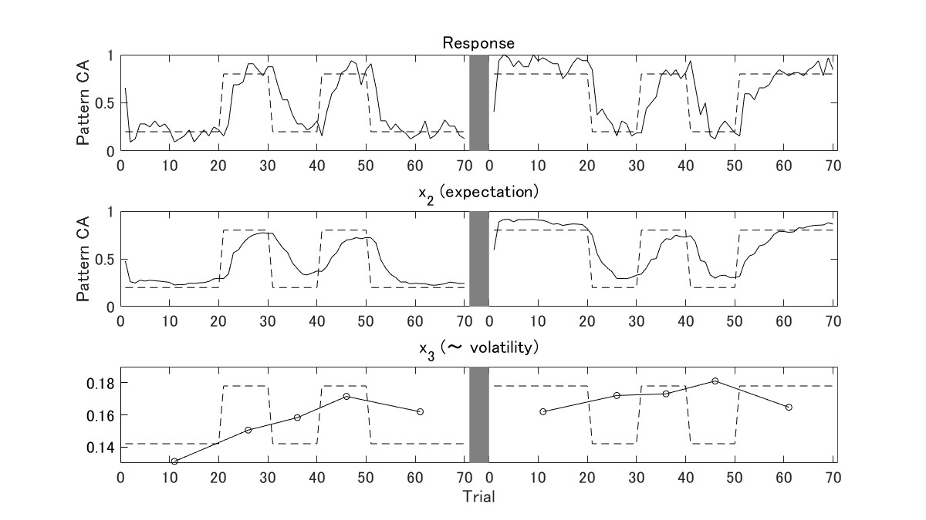
Volatility model

Slide 25
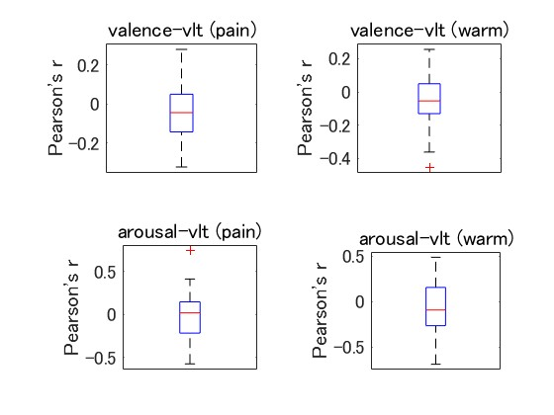
Emotion and volatility
No significant correlation found between emotion ratings and volatility

Slide 26
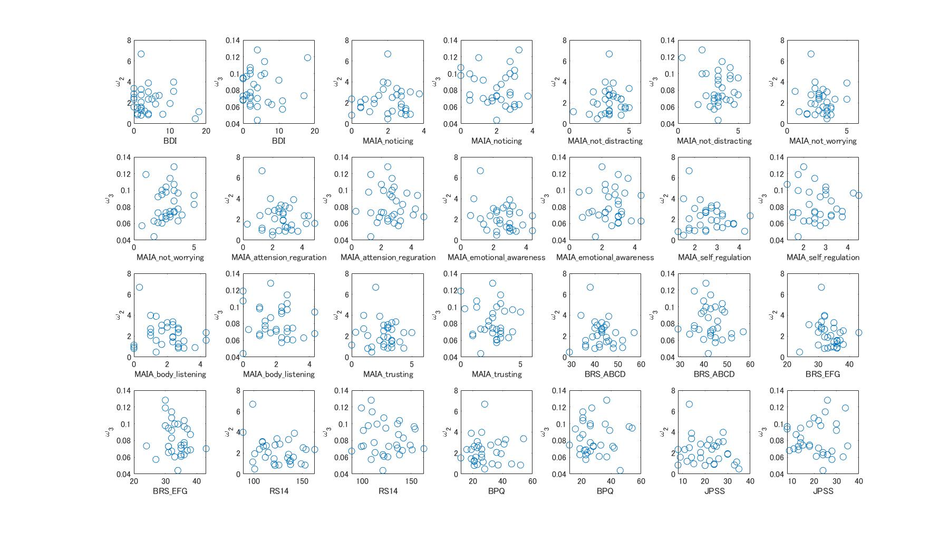
Individual difference
No significant relationship found between volatility parameters and questionnaires

Slide 27
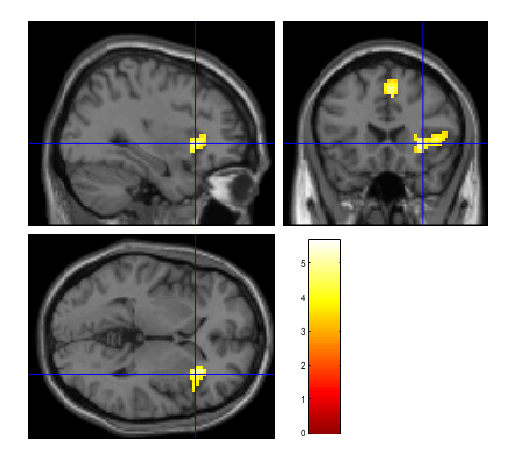
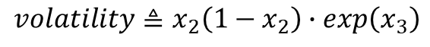
fMRI
1.0s
0.5s
3.0s
~1.0s
3.0s
4.0s
~2.5s
~3.5s
$$volatility≜x_{2}\left(1−x_{2}\right)∙exp\left(x_{3}\right)$$
fixation
Cue
2AFC
Antici-
pation
Stim
Pain
VAS
Affective
grid
1.0
1.5
4.5
5.5
8.5
12.5
15.0
18.5
SMC
aIns
There was a correlation between volatility and anterior insula activity
uncorr. p < 0.001 at peak level
FWE p < 0.05 at cluster level

Slide 28
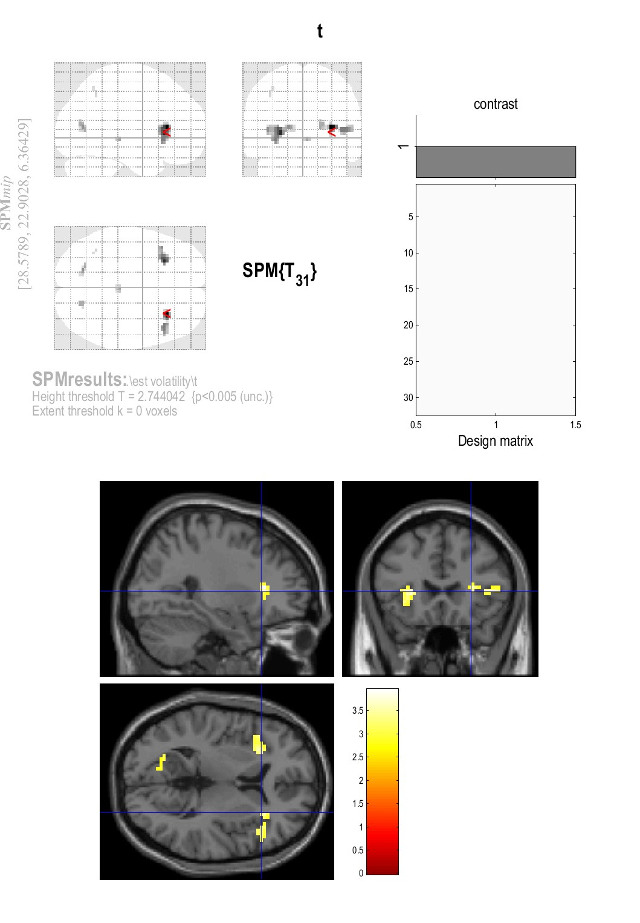
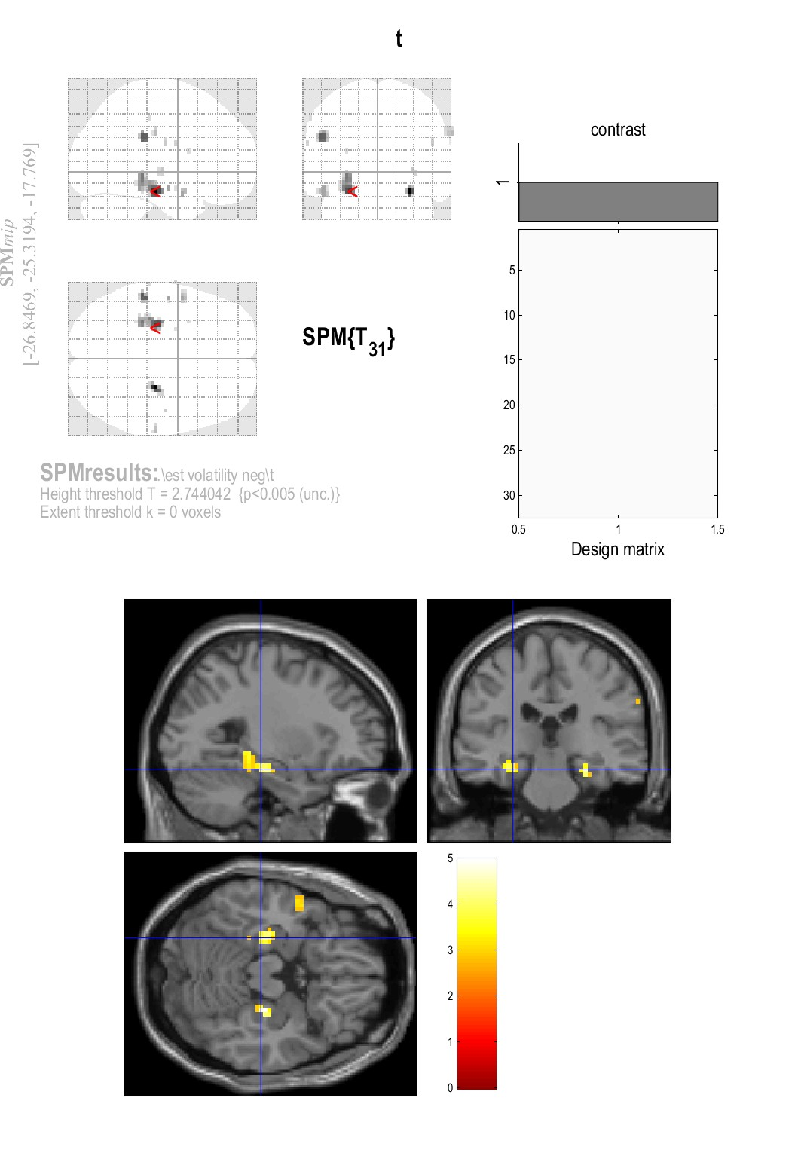
fMRI
1.0s
0.5s
3.0s
~1.0s
3.0s
4.0s
~2.5s
~3.5s
$$volatility≜x_{2}\left(1−x_{2}\right)∙exp\left(x_{3}\right)$$
fixation
Cue
2AFC
Antici-
pation
Stim
Pain
VAS
Affective
grid
1.0
1.5
4.5
5.5
8.5
12.5
15.0
18.5
Positive correlation
Negative correlation
Anterior insula
Parahippocampal
Stable -> memory
Volatile -> Intuitive, Emotional
uncorr. p < 0.005
at peak level
Notes:
In Stable condition, the memory process is working, and in Volatile condition, the intuitive or emotional process is working.
I can't conclude this way because the statistical power is so weak.

Slide 29
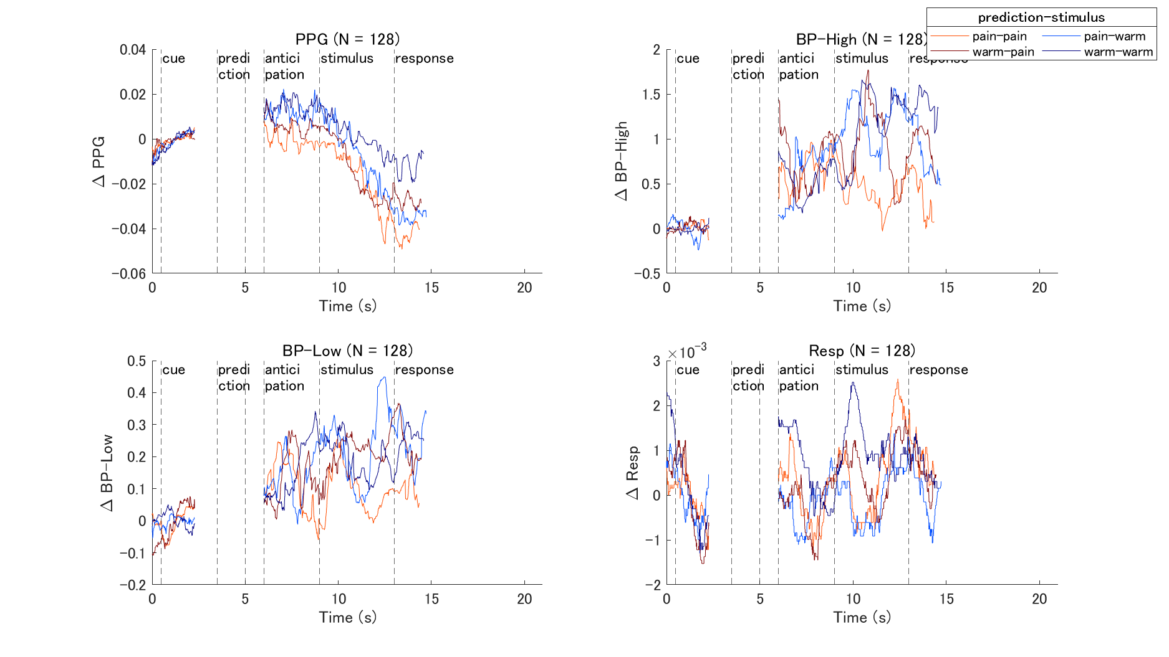

Slide 30
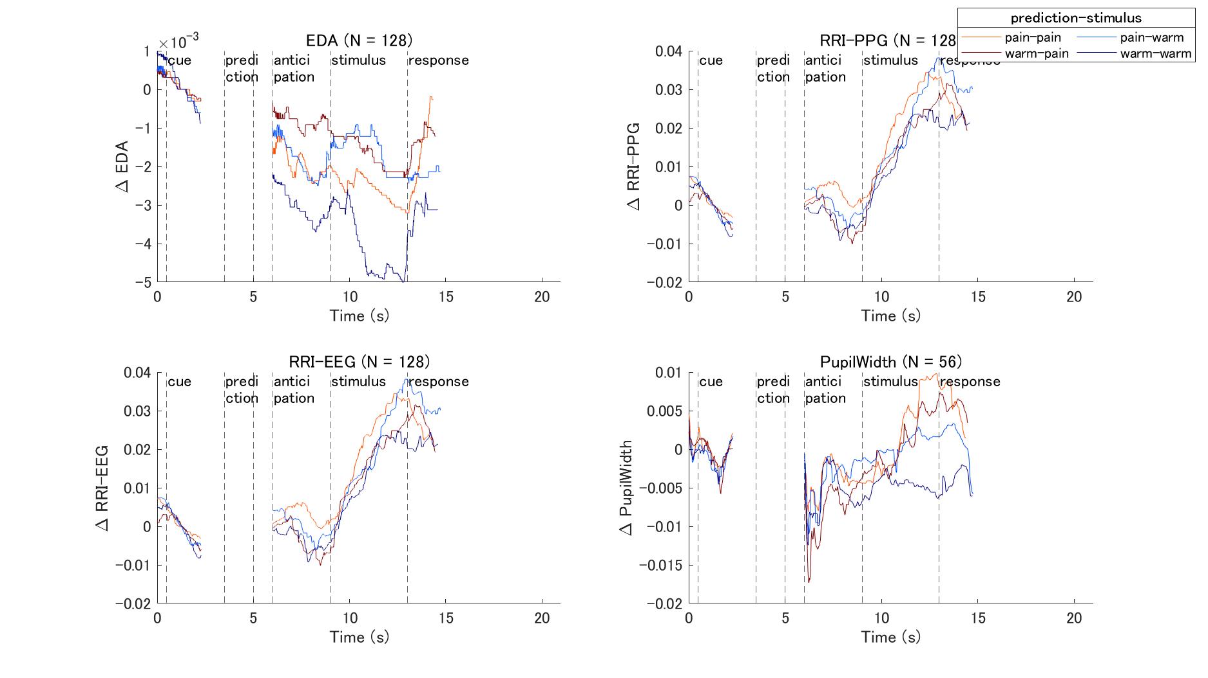

Slide 31
Summary
Volatility of pain -> insula
There was a correlation between volatility and anterior insula activity.
Volatility (free-energy) affects emotion ratings.
Valence increased when prediction was matched (decrease in free-energy).
No significant correlation found between volatility and ratings.
Volatility affects BIN measures
No significant relationship found.
Future works: HRV, HEP, EGG, EEG-fMRI
Individual differences in interoception or personality affect behavior to change in volatility
No significant relationship found.
Future works: Better behavioral model

Slide 32
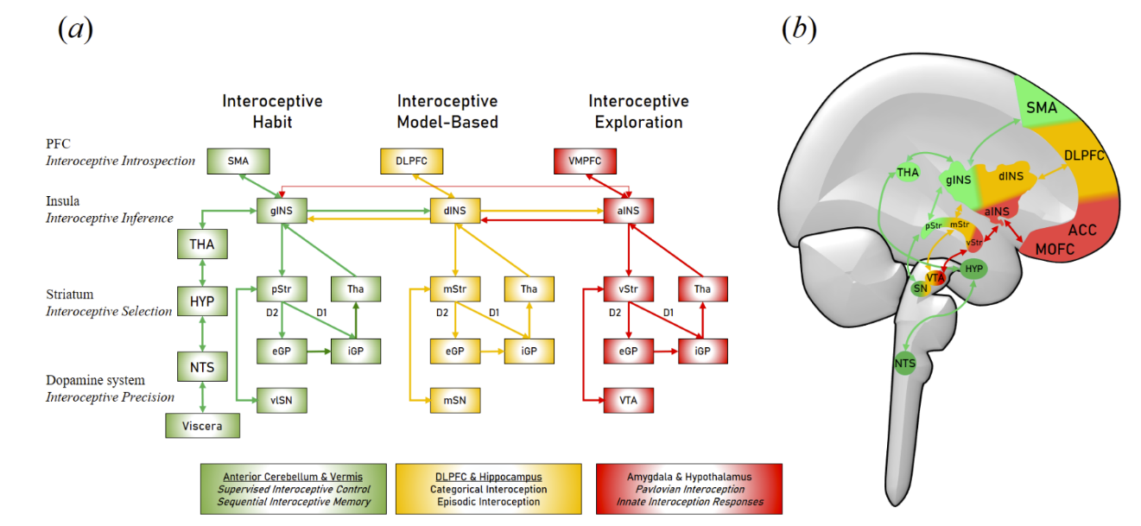
Insula, ACC
Volatility of monetary reward -> ACC (Behrens et al., 2007; Silvetti et al., 2013)
ACC presents activities related to money acquisition and loss in the task of selecting one of two actions to earn money (O'Doherty et al., 2001)
Anterior insula activates against pain volatility
Notes:
As the IMAC model says, many areas of the brain are associated with learning.
Among them, the insula is a region that directly receives pain input, so it is natural that it plays a major role in pain learning.
Previous studies have reported that volatility learning is associated with ACC activity.
However, since ACC activities are often seen in tasks that involve financial rewards, the areas involved in learning may differ depending on the type of reward.
To conclude, this study reveals that anterior insula exhibits activity related to pain volatility.

Slide 34
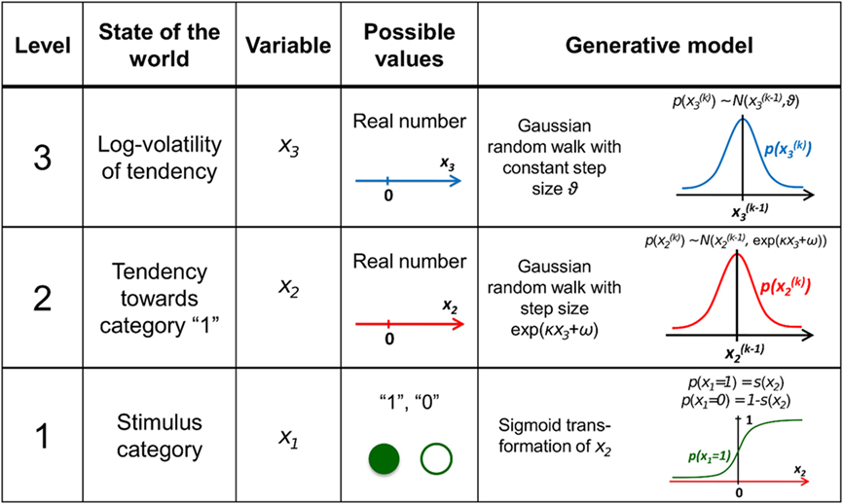
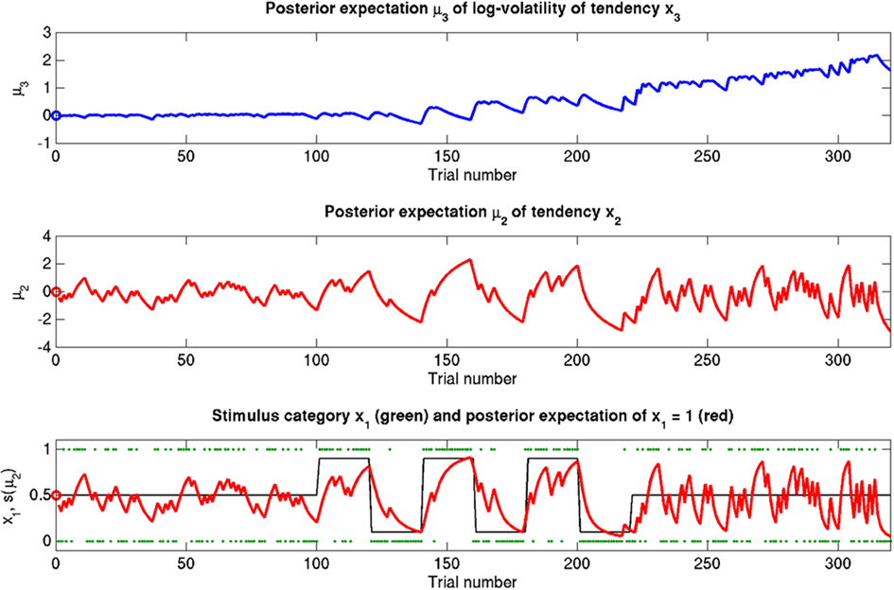
Volatility model
Mathys, C., Daunizeau, J., Friston, K., & Stephan, K. (2011). A Bayesian Foundation for Individual Learning Under Uncertainty. Frontiers in Human Neuroscience, 5(39).
Pain stimulus
Ratio of pain
stable
volatile
stable

